Slide 1
Unit testing with junit & mockito
March 2020

Slide 2
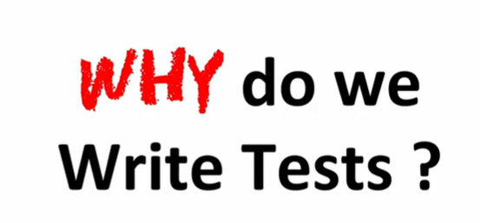

Slide 3
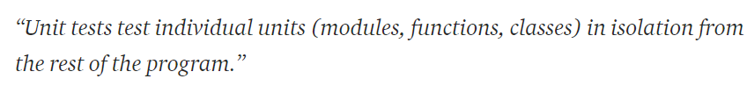

Slide 4
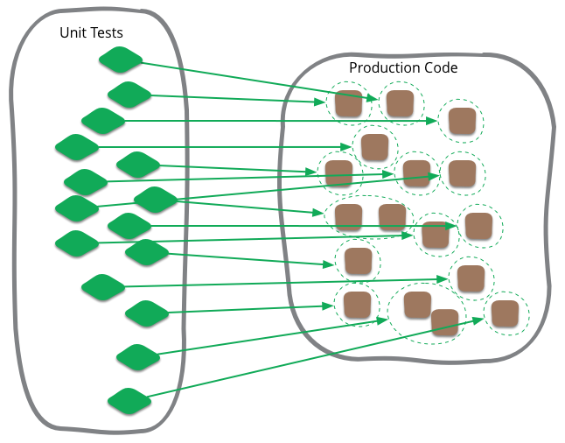
https://martinfowler.com/bliki/UnitTest.html

Slide 5
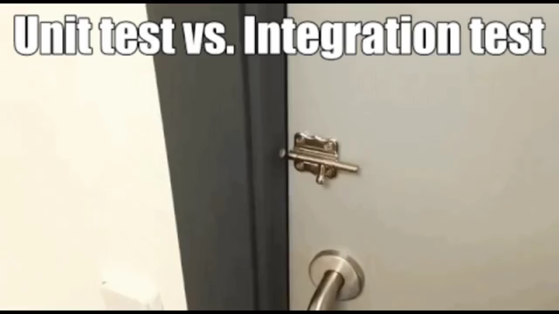

Slide 6
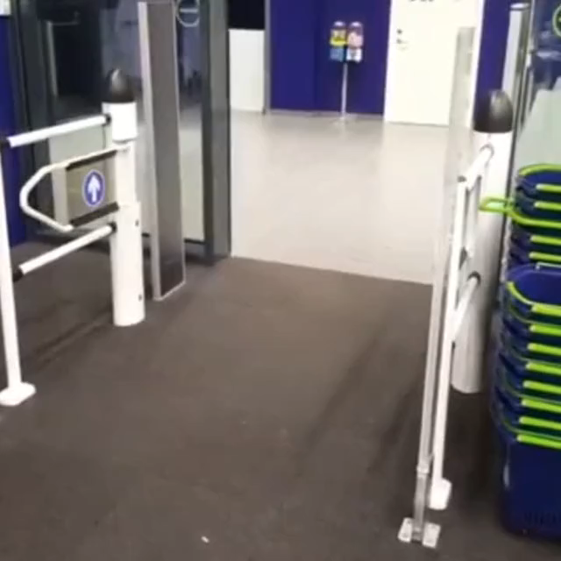

Slide 7
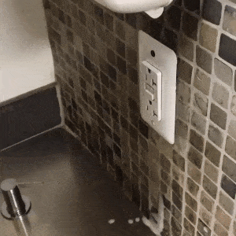

Slide 8

expect(umbrellaOpens).toBe(true)
tests: 1 passed, 1 total **all tests passed**

Slide 9

Live coding: writing a stack

Slide 10


Slide 11


Slide 12


Slide 13
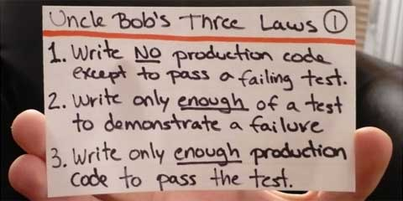

Slide 14
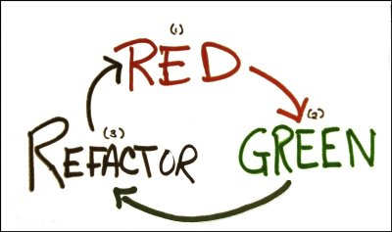

Slide 15
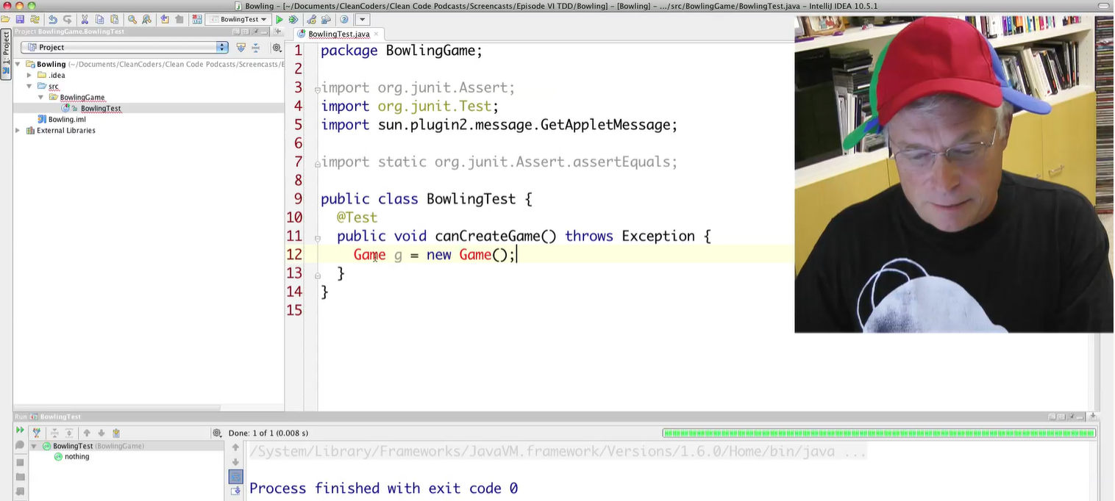

Slide 16
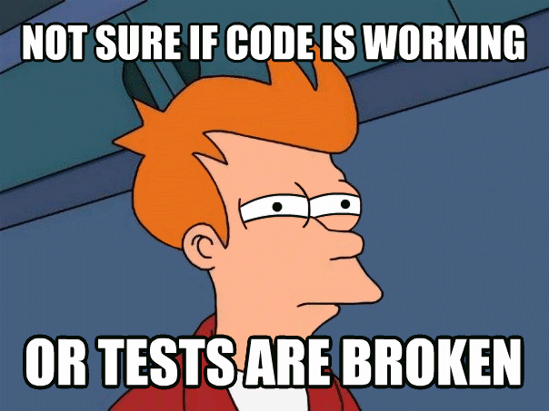

Slide 17
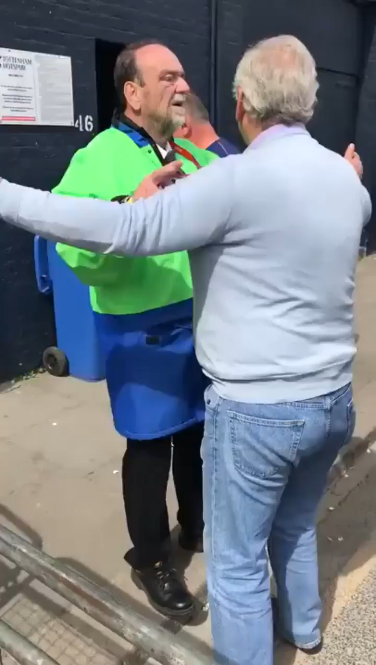

Slide 18
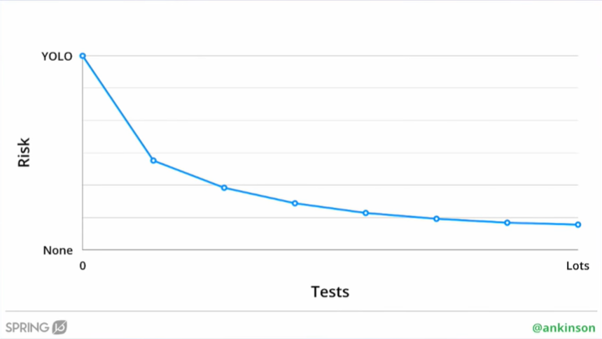
https://www.youtube.com/watch?v=5sjFn9BsAds

Slide 19
Test lifecycle

Slide 20
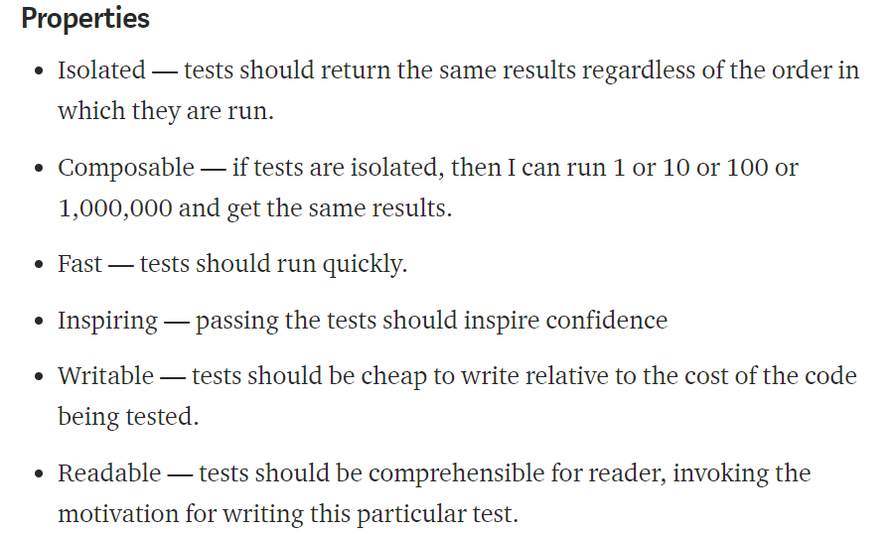
https://medium.com/@kentbeck_7670/test-desiderata-94150638a4b3

Slide 21
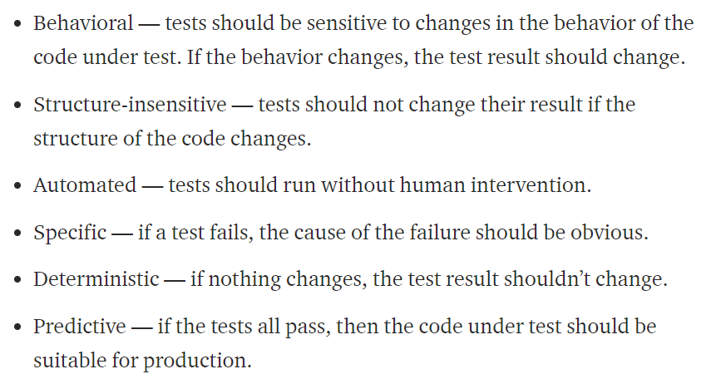
https://medium.com/@kentbeck_7670/test-desiderata-94150638a4b3

Slide 22
Integration test vs unit test
A test is not a unit test if:
It talks to the database
It communicates across the network
It touches the filesystem
It can’t run at the same time as any of your other unit tests
You have to do special things to your environment (such as editing config files) to run it

Slide 23


Slide 24


Slide 25


Slide 26
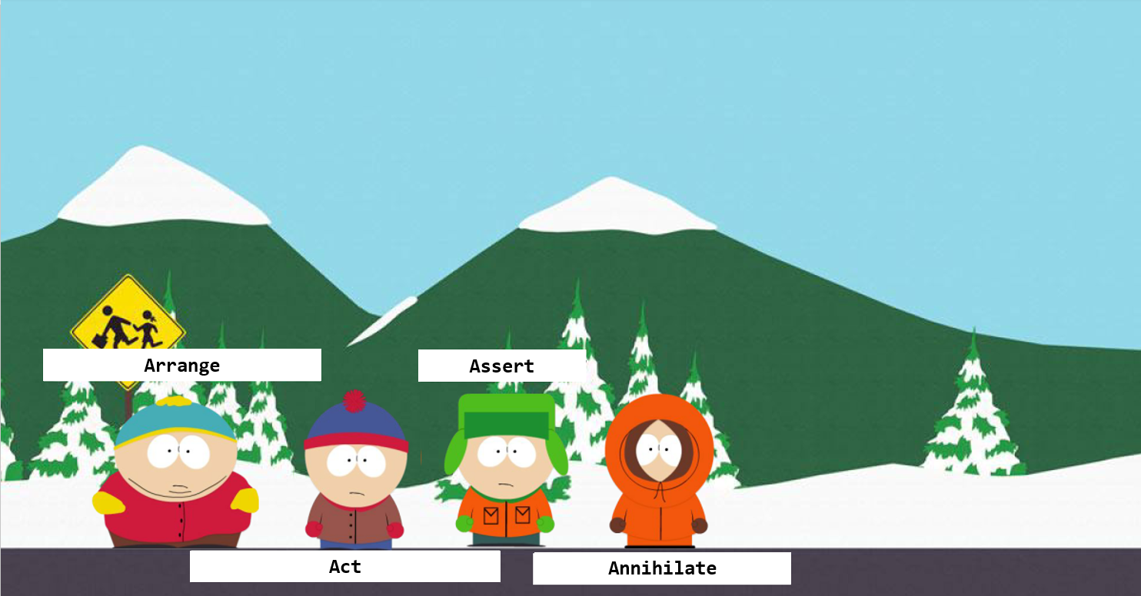

Slide 27
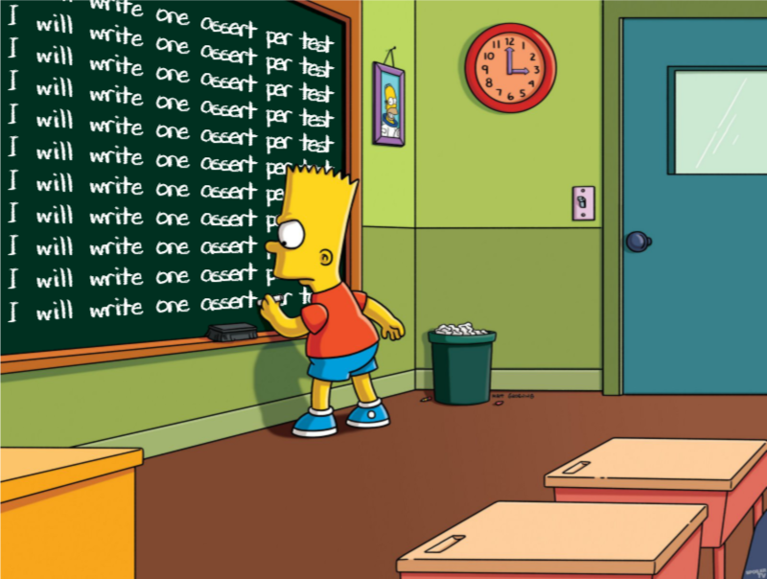

Slide 28
App demo

Slide 29
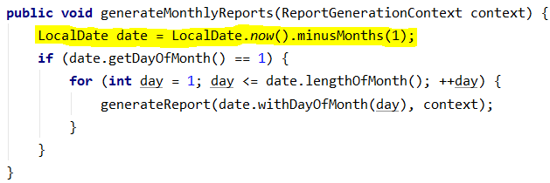

Slide 30


Slide 31
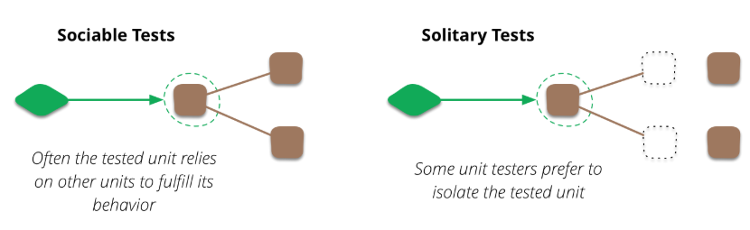
https://martinfowler.com/bliki/UnitTest.html

Slide 32

Introduction to mocking a.k.a test doubles

Slide 33
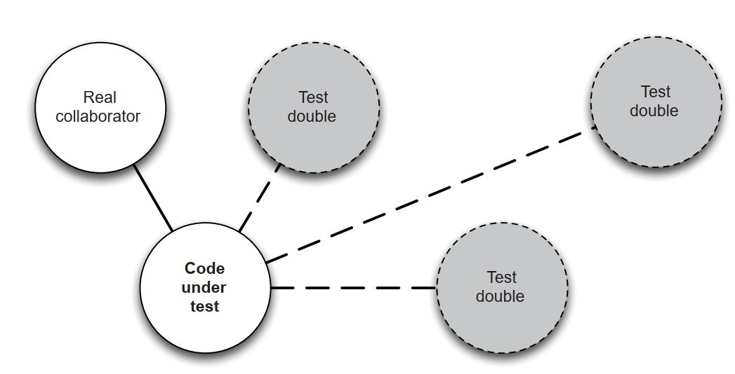

Slide 34
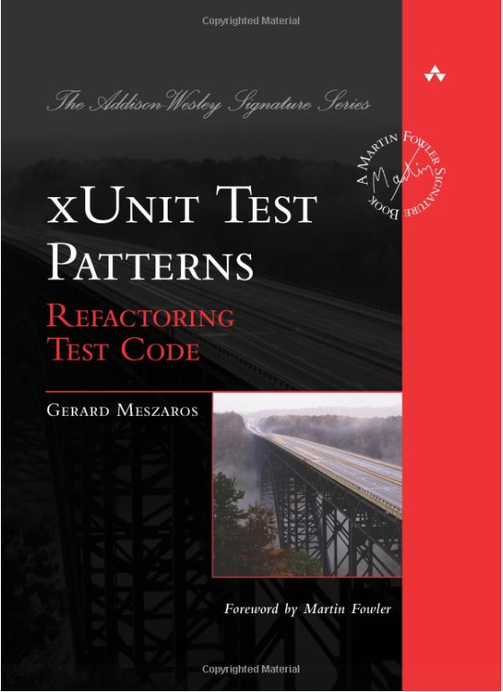

Slide 35
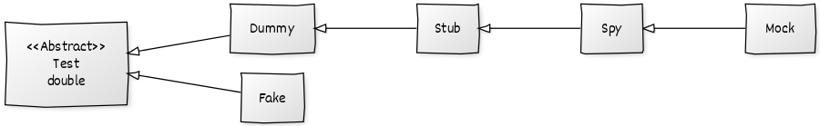
The ontology of mock objects
https://martinfowler.com/articles/mocksArentStubs.html

Slide 36
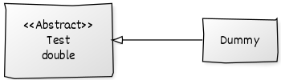
The dummy

Slide 37
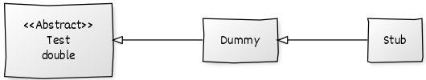
The stub

Slide 38
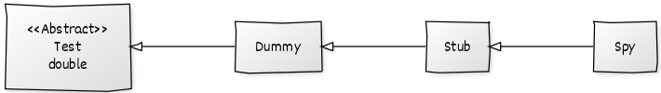
The spy

Slide 39
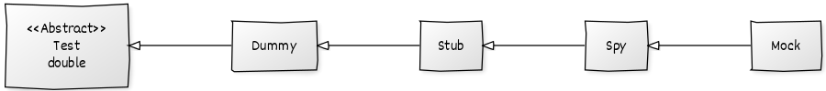
The mock

Slide 40
The fake

Slide 41
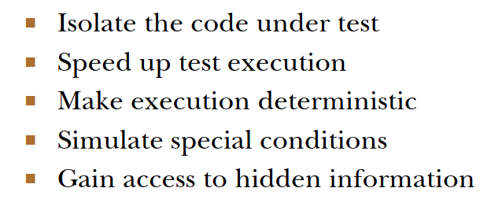
What mock objects do

Slide 42
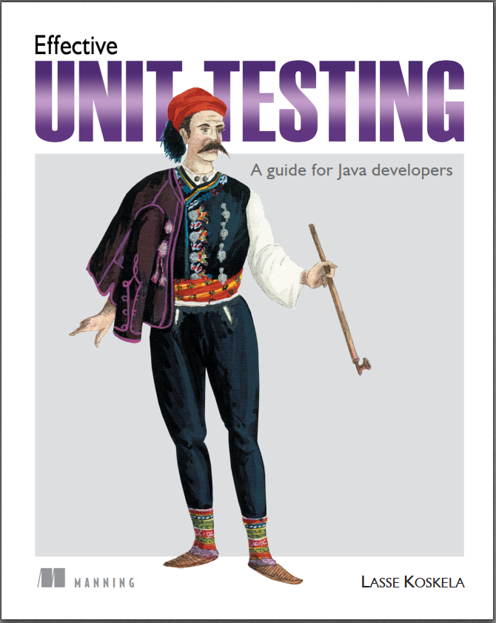

Slide 43
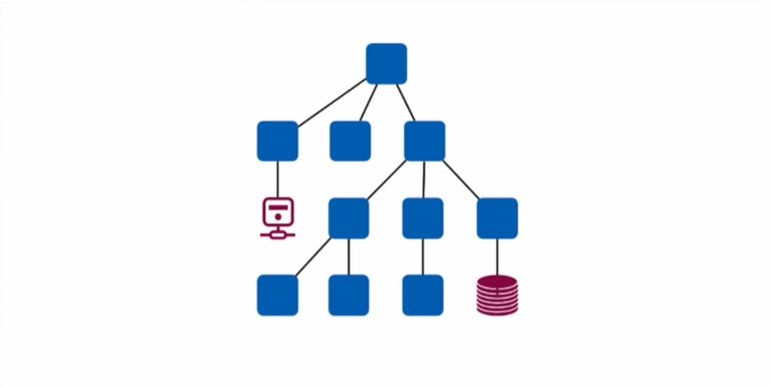
https://www.youtube.com/watch?v=5sjFn9BsAds

Slide 44
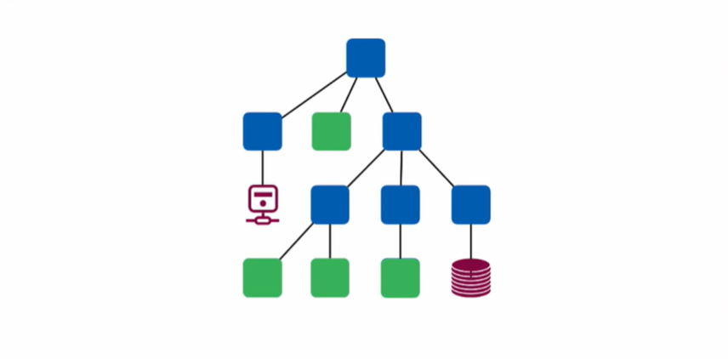
https://www.youtube.com/watch?v=5sjFn9BsAds

Slide 45
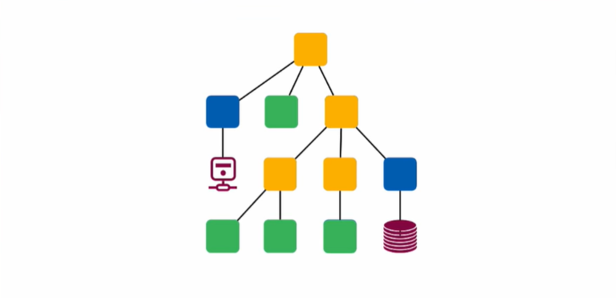
https://www.youtube.com/watch?v=5sjFn9BsAds

Slide 46

https://www.youtube.com/watch?v=5sjFn9BsAds

Slide 47

https://www.youtube.com/watch?v=5sjFn9BsAds

Slide 48


Slide 49
Mockito demo

Slide 50
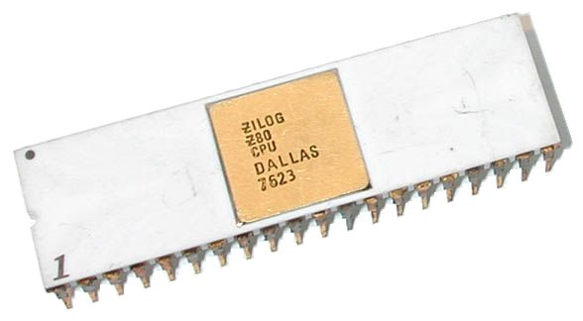

Slide 51
state vs behavior

Slide 52
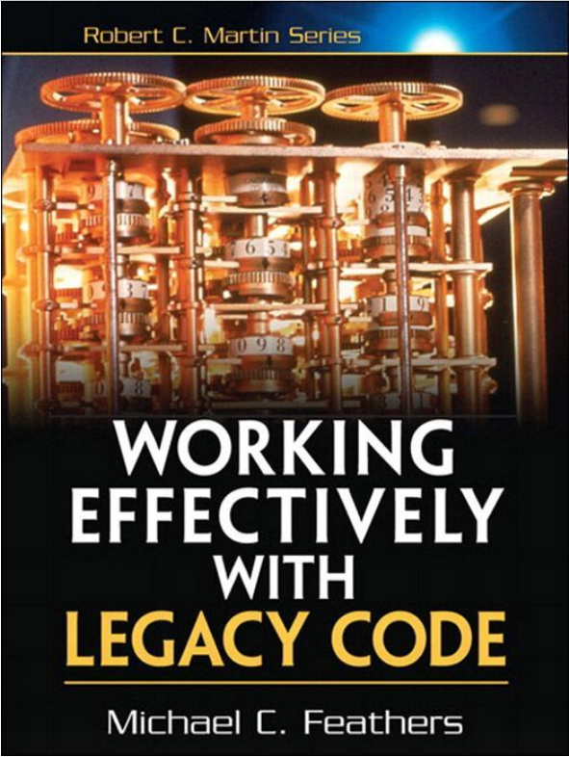

Slide 53
Working with legacy code

Slide 54
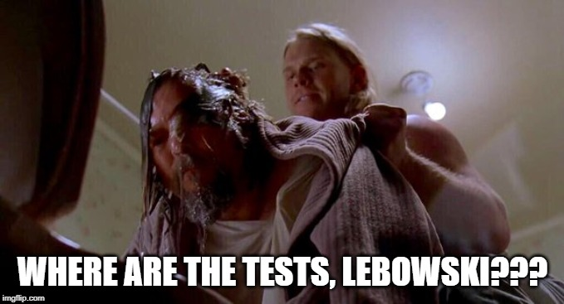

Slide 55
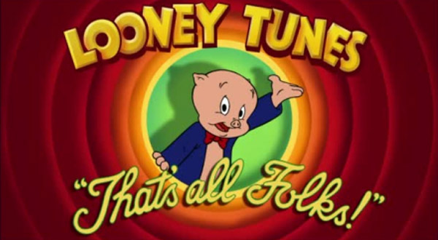
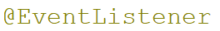
Recap
Use instead of
If the event was fired from a transaction

Slide 56

THANK YOU
Andrei Roșca
Java developer
Andrei.Rosca@endava.com
https://github.com/anrosca/unit-testing-with-junit-and-mockito

